Slide 1
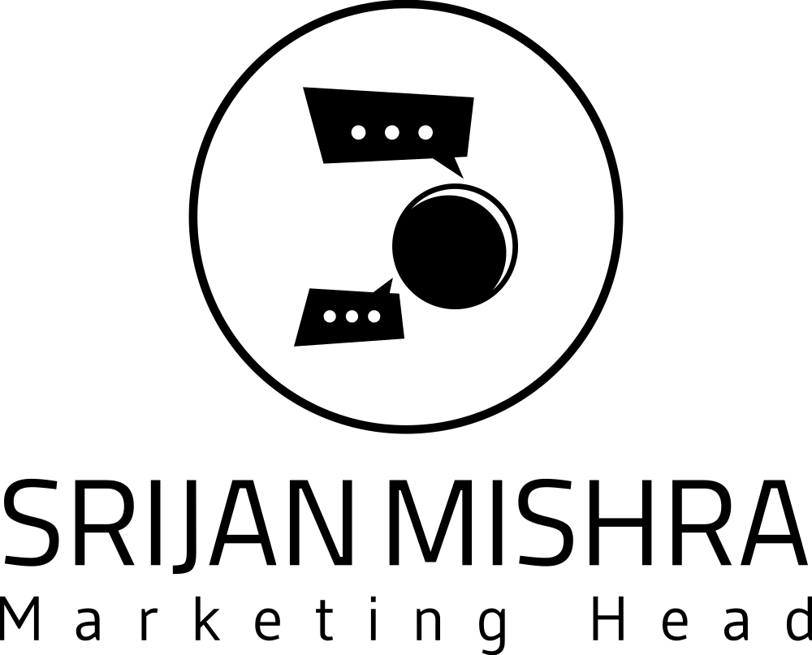

Marketing Strategy

Slide 2
Table of Contents
01
02
03
04
05
06
ANALYSIS
BRAND AWARENESS
GOALS
Basic analysis of the SI website and social media
Marketing Strategy to create brand awareness
Objective and strategies to achieve them
BUDGET FORECASTING
RESOURCES
TIMELINES
Approximation of budget and possible achievable results
Manpower and resources needed to execute the plan
Monthly, quarterly and yearly timelines to achieve the goals

Slide 3
Analysis
01
Website
The website’s design looks elegant and upto the mark. (we can still utilize slider covers)
Smart Interview’s website offers a variety of resources, including practice questions, interview tips, and resume templates.
The website lacks blogs or more informative content, which plays a vital role in improving website’s organic reach via SEO.
SI’s main competitors are other platforms that offer similar services, such as Bainify and IMTC.

Slide 4
Target Audience
Primary
Secondary
Coding Bootcamp Graduates
CS,IT Students
Self-taught Coders
Job Seekers
Experienced Developers
Freelancers & Contractors
Coding Enthusiast
Career Changers

Slide 5
Awareness
Strategy
02
In order to create brand awareness here are a few things that we can implement:
Omnichannel Approach: In order to improve brand awareness, we need to target each and every platform, including Twitter & Reddit.
Logo/Tagline: The brand tagline has scope of improvement, it’ll be beneficial if it could communicate well to the audience.
Influencer Marketing: We can partner with influencers in the Ed-tech industry or even career coaches to spread the awareness and gain credibility.
Podcasts: Video content is the best way to communicate with audience, we can organise podcasts with the mentors, people from IT industry, Ed-tech industry, etc. and utilise the bytes to push on our social media channels as well.

Slide 6
Awareness
Strategy
Direct Marketing: To boost conversion potential and reach decision-makers such as schools, colleges and institutes, we can use personalized mailers, flyers, brochures, etc.
Social Cause: We can run campaigns around social cause such as helping underprivileged students, or helping in the time of recession etc.
SEO: It goes without saying that SEO plays a vital role in creating brand recognition, by creating informative blog-posts and targeting desired keywords, we can effectively create awareness generating to leads and conversions.
Industry Events: These events are great opportunity to create brand awareness, meet potential investors and partners and get more leads, it is best to leverage that.

Slide 7
Goals
03
SMART Goals
It's important to establish specific, measurable, achievable, relevant, and time-bound (SMART) goals for each objective and regularly track progress using relevant metrics and analytics tools.
Ultimately generating to more revenue and profitability.

Slide 8
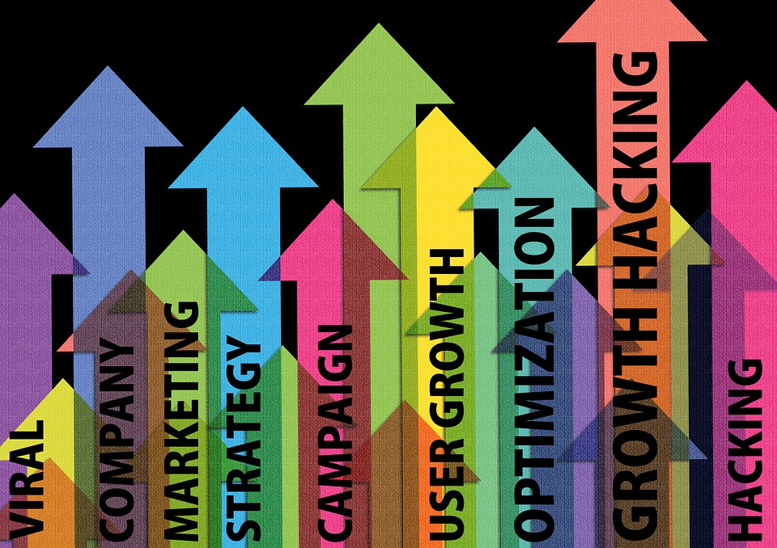
Goals
Increase User Acquisition
Enhance Course Enrolment
Improve Course Completion Rate
Foster User Engagement
Establish Brand Authority
Expand Industry Partnerships
Enhance User Experience
Increase Revenue and Profitability
JUPITER

Slide 9
Budget
Forecasting
04
Digital Marketing
Search Engine Optimization (SEO): INR 30,000 - 1,50,000 per month (depending on the competitiveness of keywords and desired results).
Pay-Per-Click (PPC) Advertising: INR 10,000 - 1,50,000 per month (the cost will vary based on the targeted keywords and ad campaign scale).
Social Media Marketing: INR 15,000 - 60,000 per month (including content creation, community management, and ad campaigns on platforms like Facebook, Twitter, LinkedIn).
Content Marketing: INR 10,000 - 50,000 per month (creating and promoting valuable content like blog posts, ebooks, whitepapers, and infographics).

Slide 10
Budget
Forecasting
Digital Marketing
Influencer Marketing: INR 10,000 - 1,50,000 per campaign, it varies if we want to go with nano influencers, micro, macro, and so on (collaborating with influencers or industry experts to promote the platform).
Email Marketing: INR 5,000 - 50,000 per month (utilizing email campaigns and newsletters to engage with potential learners).
NOTE: These costings are rough estimations only and varies on the quality and whether if we are outsourcing or have in-house teams, etc.

Slide 11
Resources - Manpower
Planning
05
Manpower planning and resources are subject to various factors, here’s a general idea and their roles (teams can have associates and interns as well):
Content Writer: Creating engaging and informative content for blogs, social media, email marketing, and website.
Social Media Manager: managing social media platforms, community engagement, and running ad campaigns.
SEO Specialist: optimizing website content, conducting keyword research, and implementing SEO strategies.
Graphic Designer & Video Editor: designing visuals, banners, infographics, and other marketing collateral.
Marketing Coordinator: assisting in various marketing activities, coordinating campaigns, and managing analytics.

Slide 12
Timelines
06
One Year Timeline
3 Months
Conduct a comprehensive review of current marketing strategies and performance.
Refine and optimize digital marketing campaigns based on data analysis, user feedback, and market trends.
Implement targeted email marketing campaigns to engage with existing users and nurture leads.
Enhance search engine optimization (SEO) strategies to improve organic visibility and increase website traffic.
Collaborate with industry influencers or thought leaders for co-marketing initiatives and guest content contributions.
Monitor and analyze key performance indicators (KPIs) such as website traffic, course enrollment, user engagement, and conversion rates.

Slide 13
Timelines
6 Months
Launch a referral program or loyalty program to encourage existing users to refer new users and incentivize continued engagement.
Develop and implement a content marketing strategy to create valuable and educational content relevant to the target audience.
Expand social media presence and engagement by running targeted ad campaigns, hosting live Q&A sessions, and sharing user success stories.
Explore partnerships with coding communities, industry forums, or relevant organizations to reach new audiences and expand brand visibility.
Evaluate the effectiveness of marketing channels and campaigns, making adjustments and optimizations based on performance metrics.

Slide 14
Timelines
9 Months
Launch targeted marketing campaigns aligned with specific events, such as coding competitions, industry conferences, or seasonal promotions.
Develop case studies and success stories highlighting the achievements of users who have benefited from Smart Coder's courses.
Implement remarketing campaigns to re-engage with users who have shown interest but have not yet converted into paying customers.
Explore strategic partnerships with coding bootcamps, educational institutions, or corporate training programs to offer bundled packages or exclusive discounts.

Slide 15
Timelines
12 Months
Conduct a comprehensive marketing review to assess the effectiveness of different marketing strategies and channels over the past year.
Expand into new markets or target additional segments within the coding industry, considering regional preferences or niche specializations.
Continue to innovate and update the platform's course offerings, incorporating new technologies, coding languages, or emerging trends.
Establish strategic partnerships with coding companies, industry influencers, or thought leaders to further enhance brand authority and credibility.

Slide 16
Resources
Note: The strategies and numbers that I’ve provided lay between the best practices in the industry which I myself have used and produced exceptional results
Reources
(1) Top 5 EdTech Marketing Strategies to Grow Market Share. https://rocketium.com/academy/edtech-marketing-strategies/.
(2) 10 Innovative Digital Marketing Strategy For Edtech Companies. https://echovme.in/blog/digital-marketing-strategy-for-edtech-companies/.
(3) Smart Interviews - Ace you next coding interview. https://smartinterviews.in/.
(4) Smart Interviews. https://smartinterviews.in/login.
(5) Smart Interviews | LinkedIn. https://in.linkedin.com/company/smart-interviews.
(6) Smart Interviews: Contact Details and Business Profile - RocketReach. https://rocketreach.co/smart-interviews-profile_b45d56cbfc61dd2c.
(7) About | Smart Interviews. https://smartinterviews.in/about.
(8) A Window Into Ed-Tech Marketing Strategies During the Pandemic. https://marketbrief.edweek.org/marketplace-k-12/snapshot-ed-tech-marketing-strategies-pandemic/.
(9) 7 Proven Marketing Strategies for Edtech Companies - SabPaisa. https://sabpaisa.in/blog/marketing-strategies-for-edtech-companies/.
(10) https://www.ajnacreator.com/ (From designing the webpage, to directing the script an running ads, I’ve done it all.
(11) Google, Bing, AI

Slide 17
Thank You

